Slide 1
Task Overview
Title: Task 4 – Sales & Financial Dashboard Content:
In this task, I created an interactive business dashboard using Power BI, leveraging the Kaggle - Global Superstore dataset.
The objective was to provide key insights into sales and profit performance to support better business decisions.

Slide 2
Dataset & Tools
Title: Dataset & Tools Used Content:
🔹 Dataset: Global Superstore (Kaggle) 🔹 Timeframe: ~2015–2018 🔹 Fields Used: Order Date, Region, Category, Sales, Profit, Segment 🔹 Tool: Power BI 🔹 Techniques: Data modeling, DAX measures, time-series analysis, slicers, KPIs

Slide 3
Dashboard Highlights
Title: Key Features of the Dashboard Content:
✅ KPIs: Total Sales, Total Profit, Profit Ratio, YoY Growth
✅ Time-Series Visuals: Sales & Profit trends over time
✅ Filters: Slicers by Region, Category, Segment, and Date
✅ Cards: Highlighting major metrics for quick insights
✅ Visual Consistency: Unified color theme & layout

Slide 4
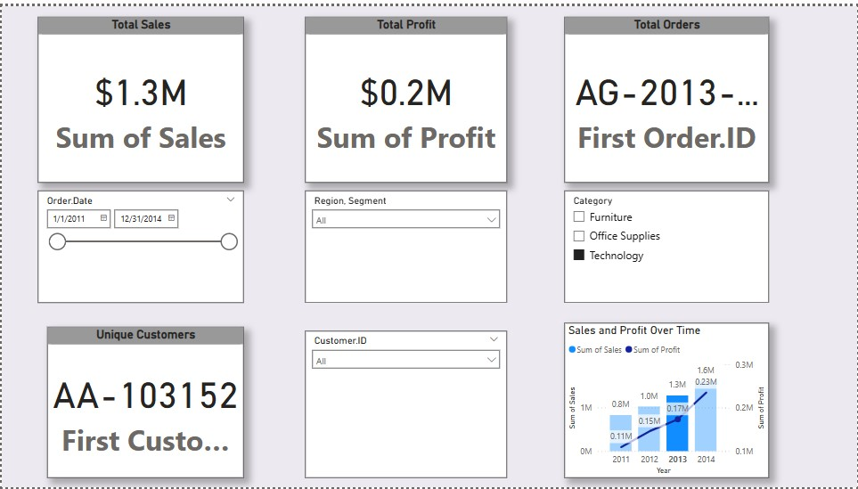
Dashboard

Slide 5
Insights Gained
📌 Top Region: West region led in total sales and profit across all years.
📌 Most Profitable Category: Technology category had the highest overall profit margin.
📌 Growth Trend: A steady YoY growth was observed from 2015 to 2017, with peak sales during Q4 each year.
📌 Underperforming Segment: The Consumer segment showed high sales volume but lower profit margins compared to Corporate and Home Office.
📌 Regional Gap: The South region had consistently lower profits despite decent sales, indicating possible cost or pricing issues.

